Slide 1
Case study and Sample Report
Reports must be written in your notbook
A report includes 5 parts:
1- Problem Description
2- Analysis
3- Design
4- Implementation
5- Testing
Hereafter, a sample report is introduced.

Slide 2
Case Study 1 Report
1- Problem Description
Each person details include code, name, and age.
Write a Java program that allows users adding a new person to the list, removing a person having a known code from the list, updating details of a known-code person, listing all managed persons in descending order of ages using a simple menu.

Slide 3
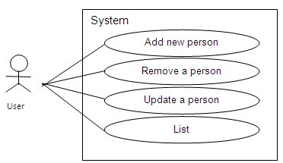
Report…
2- Analysis
From the problem description, following use-cases are identified:
System/program is expressed as a bounded rectangle.
Each function is expressed by a verb in an ellipse
User runs a function is expressed as a line

Slide 4
Report…
3- Design
3.1- Class Design
From the problem description, concepts in the problem domain are expressed by following classes:
Class Person
Description for a person
Data: String code; String name; int age
Methods: Constructors Getters, setters void input() for collecting data String toString() to get data in string format

Slide 5
Report…
Class PersonList
Description for a list of persons
Data: Person[] list; // current list int count // current number of persons
Methods: Constructors Getters, setters void add(); // add a new person. Data are collected from keyboard int find (String aCode); // Find the index of the person whose code is known void remove()// remove a person. His/ her code is accepted from keyboard void sort(); // descending sort the list based on their ages void update(); // update a person, data are accepted from keyboard void print(); // print the list

Slide 6
Report…
Class Menu
Description for a menu
Data String[] hints; // list of hints int n; // current number of hints
Methods: Menu(int n): constructor for initializing a menu containing n options void add (String aHint); // add an option int getChoice(); // get an option
Class ManagingProgram1
Description for the program
Data: none
Methods: main(…): main method of the program

Slide 7
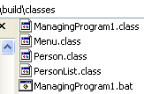
Report…
3.2- Program structure
Algorithms
Please see comments in codes.

Slide 8
Report…
3.3- User interface
Menu of the program will be seen as:
1-Add new person
2-Remove a person
3-Update a person
4-List
5-Quit

Slide 9
Report…
4- Implementation
Initial data of the program ( if any, file ………)
Please explore the software structure
Software
Please run the program
5- Testing
No. | Case | State
1 | Add new person Code: not duplicate Name: …. Age: …. | Passed Passed not passed ……
2 | Remove a person | Passed
3 | Update aperson | Passed
4 | List | ……..
… | ………………. | …..

